Slide 1

Event Processing Course
Focal points on challenging topics (related to chapter 11)

Slide 2
Lecture outline
Temporal semantics of event processing
Inexact event processing
Retraction and causality

Slide 3
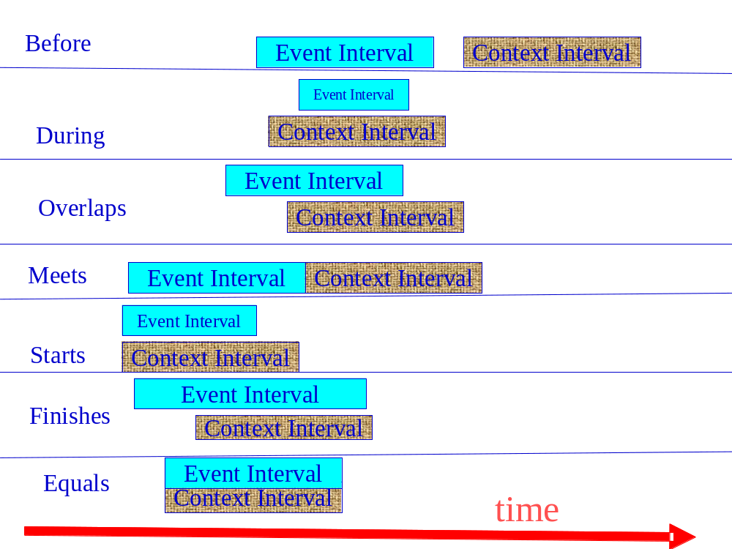
Time point vs. time interval
A time interval is a data type that designates a continuous segment in time, starting at a time point (Ts) and ending at a time point (Te).
A temporal element is a non overlapping collection of time intervals

Slide 4
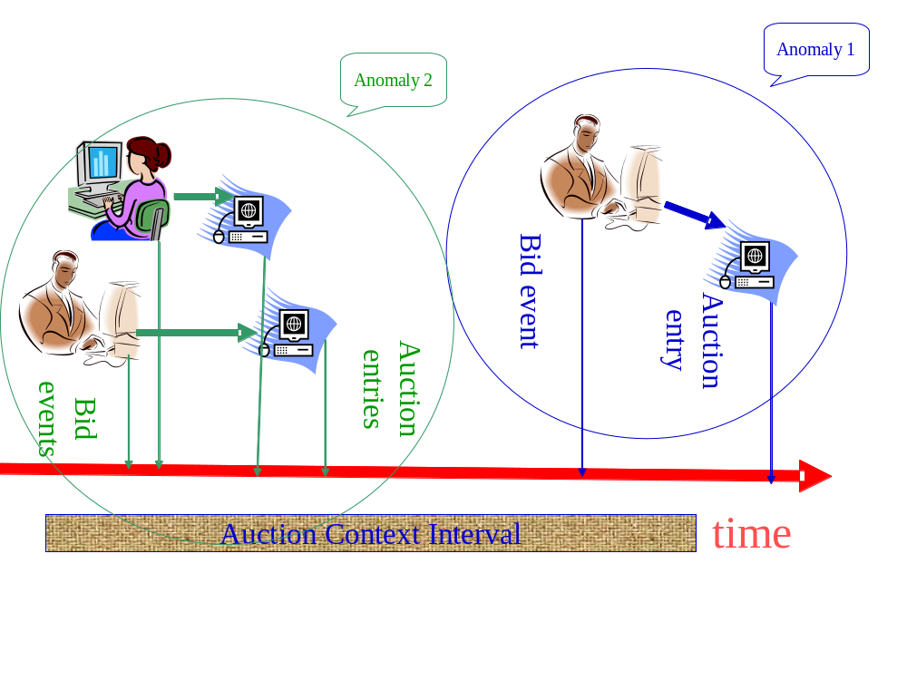
Putting derived events in order

Slide 5
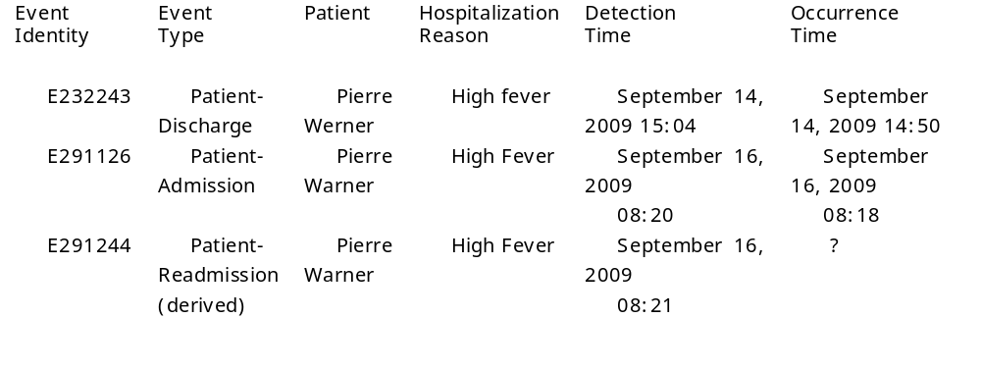
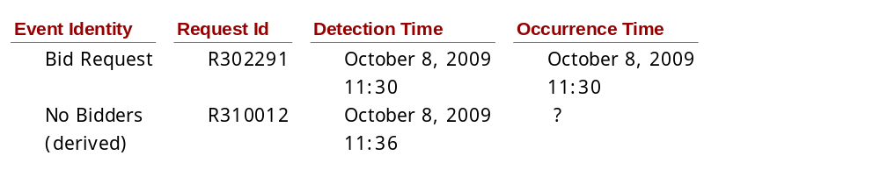
Occurrence time of derived events
Occurrence time := detection time
Occurrence time := Occurrence time of last event / expiration of context
Occurrence time := time interval that includes all relevant event/ temporal context

Slide 6
Event order and out-of-order semantics – occurrence time synchronization
  Clock synchronization
  Time server. Example: http://tf.nist.gov/service/its.htm

Slide 7
Ordering in a distributed environment - possible issues
The occurrence time of an event is accurate, but the event arrives out-of-order and processing that should have included the event might already been executed.
Neither the occurrence time nor detection time can be trusted, so the order of events cannot be accurately determined.

Slide 8
Buffering technique
Assumptions:
  Events are reported by the producers as soon as they occur;
  The delay in reporting events to the system is relatively small, and can be bounded by a time-out offset;
  Events arriving after this time-out can be ignored.
Principles:
  Let τ be the time-out offset, according to the assumption it is safe to assume that at any time-point t, all events whose occurrence time is earlier than t - τ have already arrived.
  Each event whose occurrence time is To is then kept in the buffer until To+τ, at which time the buffer can be sorted by occurrence time, and then events can be processed in this sorted order.

Slide 9
Retrospective compensation
Find out all EPAs that have already sent derived events which would have been affected by the "out-of-order" event if it had arrived at the right time.
Retract all the derived events that should not have been emitted in their current form.
Replay the original events with the late one inserted in its correct place in the sequence so that the correct derived events are generated.

Slide 10
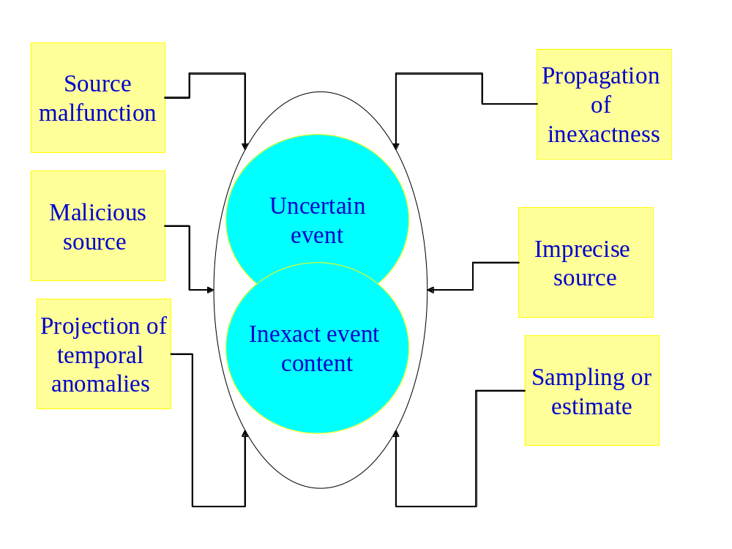
Inexact event processing
uncertainty whether an event actually occurred
inexact content in the event payload
inexact matching between derived events and the situations they purport to describe

Slide 11
False positives and false negatives
False positive situation detection refers to cases in which an event representing a situation was emitted by an event processing system, but the situation did not occur in reality.
False negative situation detection refers to cases in which a situation occurred in reality, but the event representing this situation was not emitted by an event processing system

Slide 12
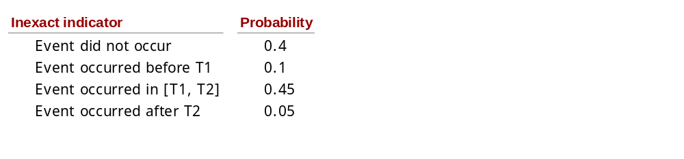
Handling inexact event processing
Example: probabilistic approach

Slide 13
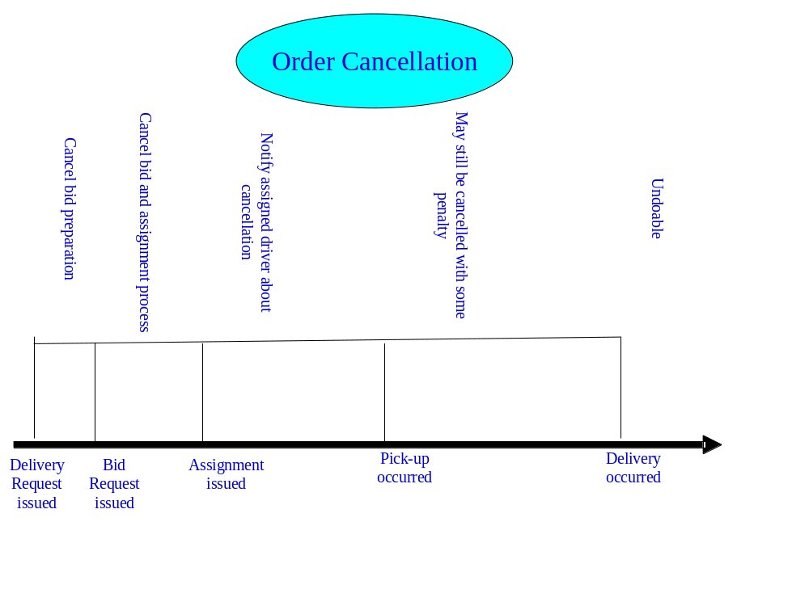
Retraction

Slide 14
Event Causality
Event Causality is a relation between two events e1 and e2, designating the fact that the occurrence of the event e1 caused the occurrence of event e2.
  Type I: predetermined causality. This type of causality refers to raw events, e1 and e2 where we know that event e2 always occurs as a result the occurrence of e1. We may thus assume that if e1 has been reported, e2 occurred whether reported or not. This occurrence may also be conditioned, for example some time offset or interval may be attached to this causality.
  Type II: Induced causality. The event e1 is an input to an EPA a1, and the derived event e2 is the output of a1.
  Type III: Potential causality. The event e1 is an event that is sent from an EPN to a consumer c1. The actions of c1 are beyond the borders of the event processing system, but c1 also acts as an event producer and can produce events of type e2. The event processing system cannot know, without further knowledge, whether there is indeed causality among events e1 and e2, but cannot rule out this possibility.

Slide 15
Summary
In the lecture we discussed:
Temporal semantics issues: temporal intervals, occurrence time of derived events, and keeping events in order
Inexact event processing, false positives and false negatives
Retraction
Causality

